Slide 1
Oscillator Circuits

Slide 2
Significance
In the design of electronic systems, standard waveforms are needed
Sinusoidal, square, triangular or pulse
Clock pulses are required in computer & Control systems
In communication systems, Testing and Measurement systems a variety of signals are required
In this lecture we will study how we can generate different signals using different oscillator circuits

Slide 3
Two main Types of Oscillators
Two distinctly different approaches for the generation of the standard waveforms
Linear oscillators :
Normally generates Sinusoidal waveforms
Employs a positive-feedback loop consisting of an amplifier and an RC or LC frequency-selective network
2. Non-linear oscillators : Circuits that generate square, triangular, pulse (etc.) waveforms, called nonlinear oscillators or function generators, employ circuit building blocks known as multivibrators. There are three types of multivibrator: the bistable, the astable, and the monostable

Slide 4
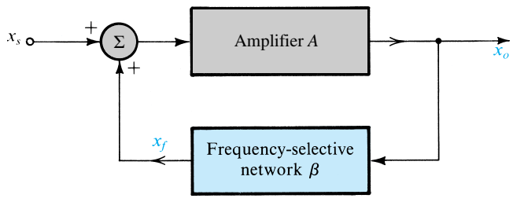
Sinusoidal Oscillators
The basic structure of a sinusoidal oscillator consists of an amplifier and a frequency selective network connected in a positive-feedback loop

Slide 5
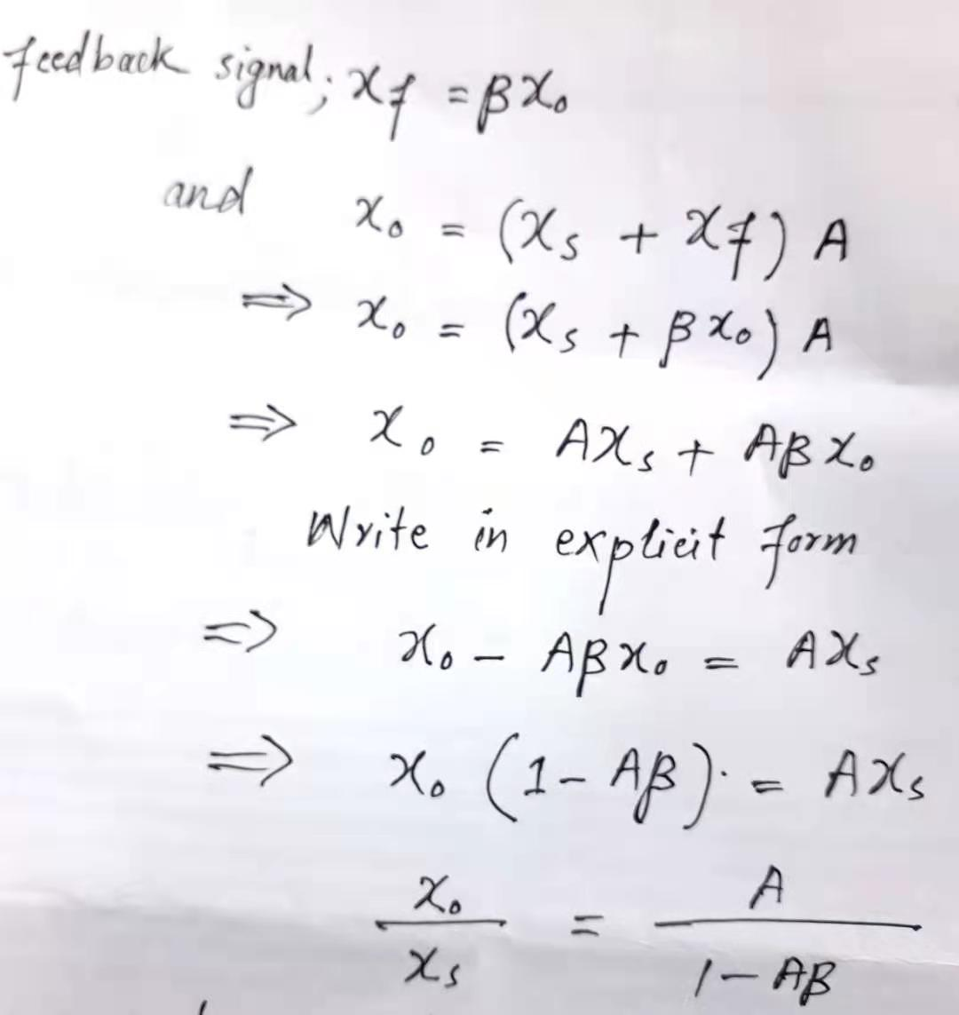


Linear Oscillators Oscillation Criterion (Barkhausen criterion)
It states taht, at ωo the phase of the loop gain should be zero and the magnitude of the loop gain should be unity.

Slide 6
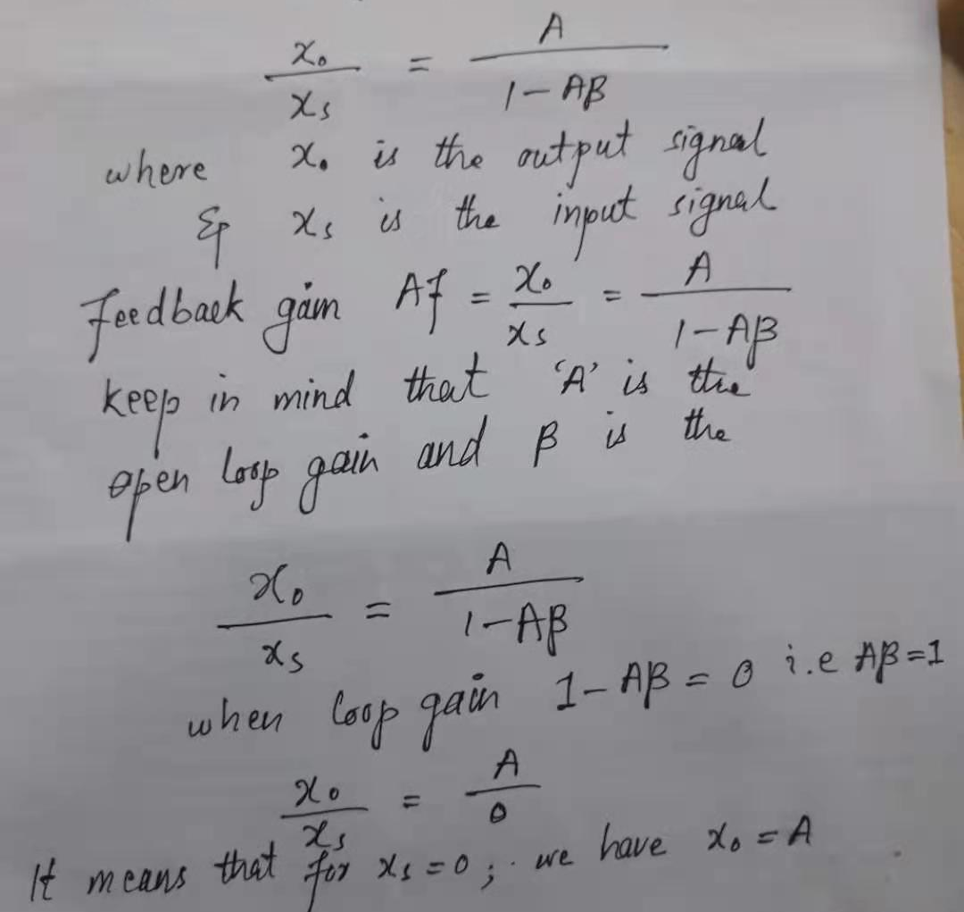


Slide 7
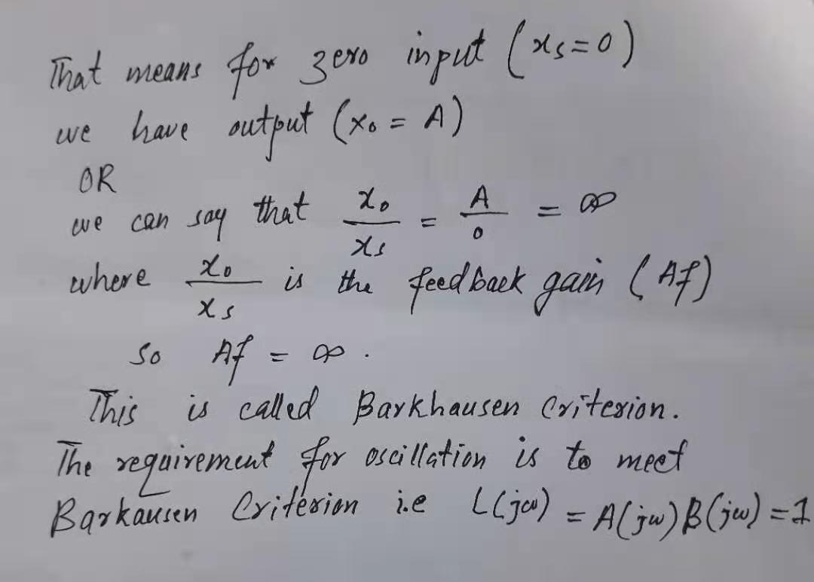
That is, at ωo the phase of the loop gain should be zero and the magnitude of the loop gain should be unity.

Slide 8
Op Amp-RC Oscillator Circuits
Using Barkausen Criterion many oscillators circuits can be developed. Some types are given here
The Wien-Bridge Oscillator
The Phase Shift Oscillator
The Quadrature Oscillator
The Active Filter Tuned Oscillator

Slide 9
LC & Crystal Oscillators
LC-Tuned Oscillators
Colpitts and
Hartley
Crystal Oscillators

Slide 10
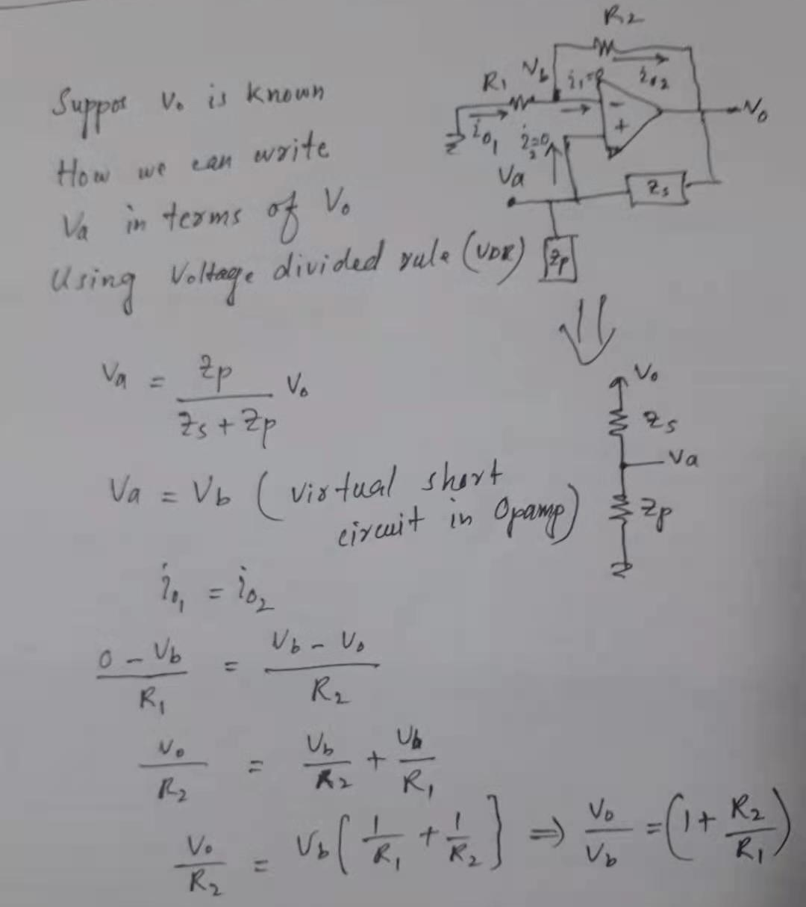
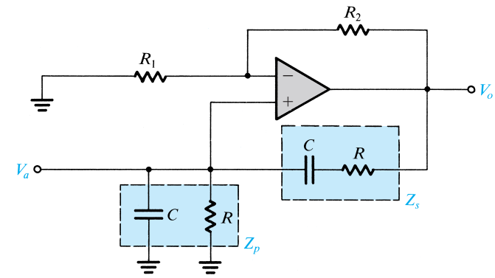
The Wien-Bridge Oscillator

Slide 11
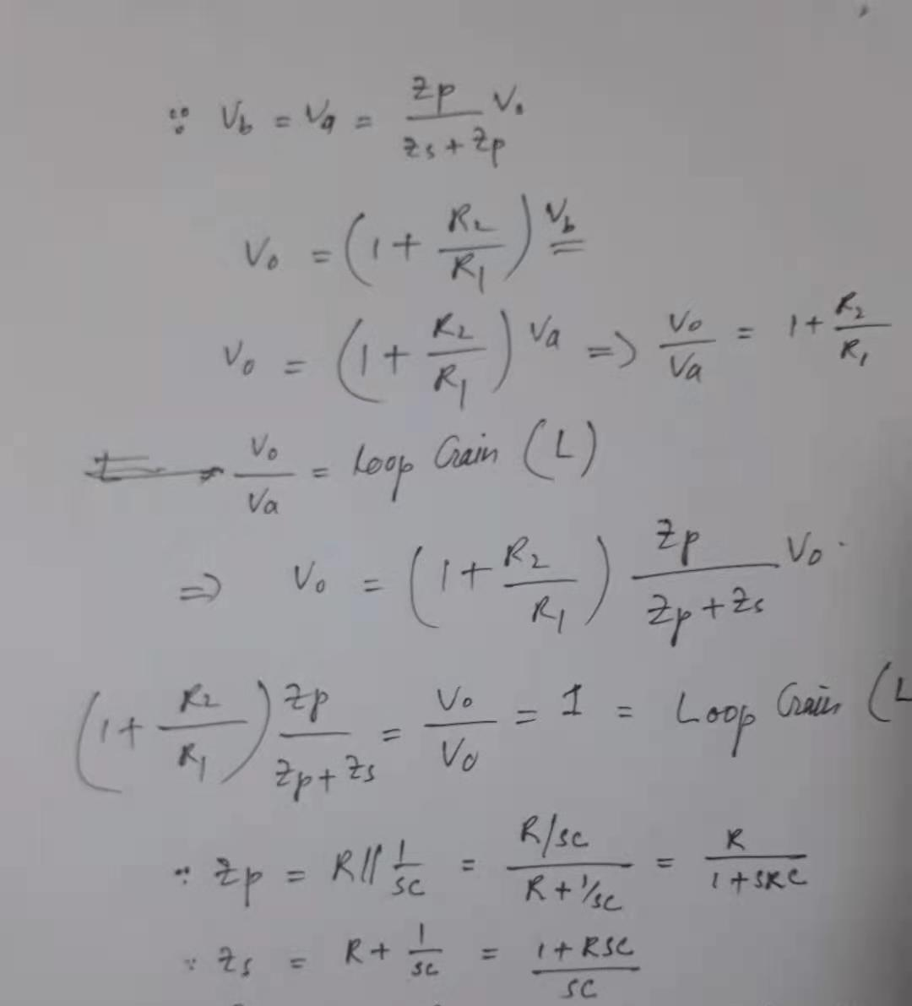

Slide 12
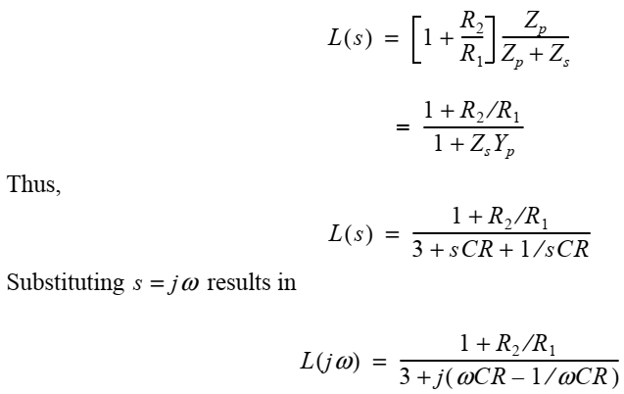


The Wien-Bridge Oscillator

Slide 13
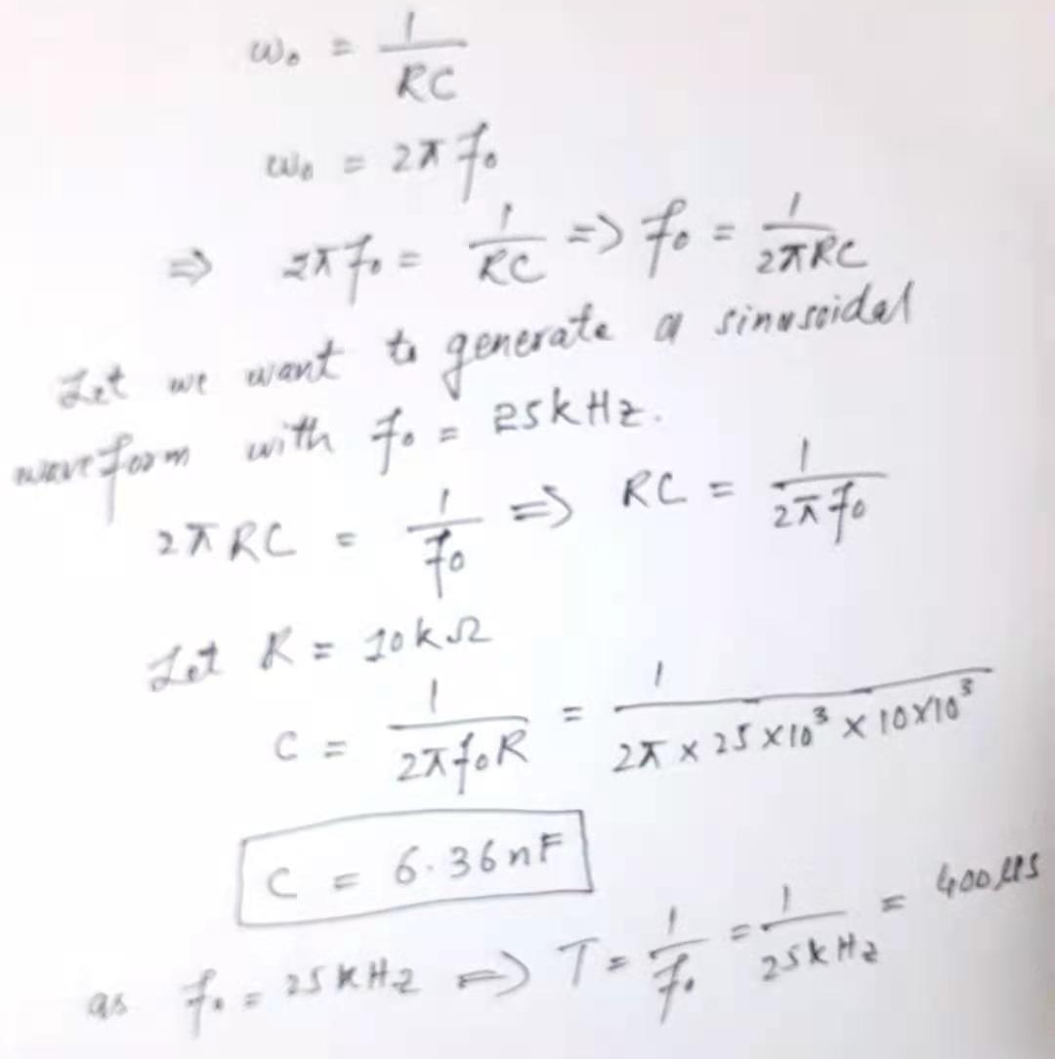
Generating 25kHz Sine wave

Slide 14
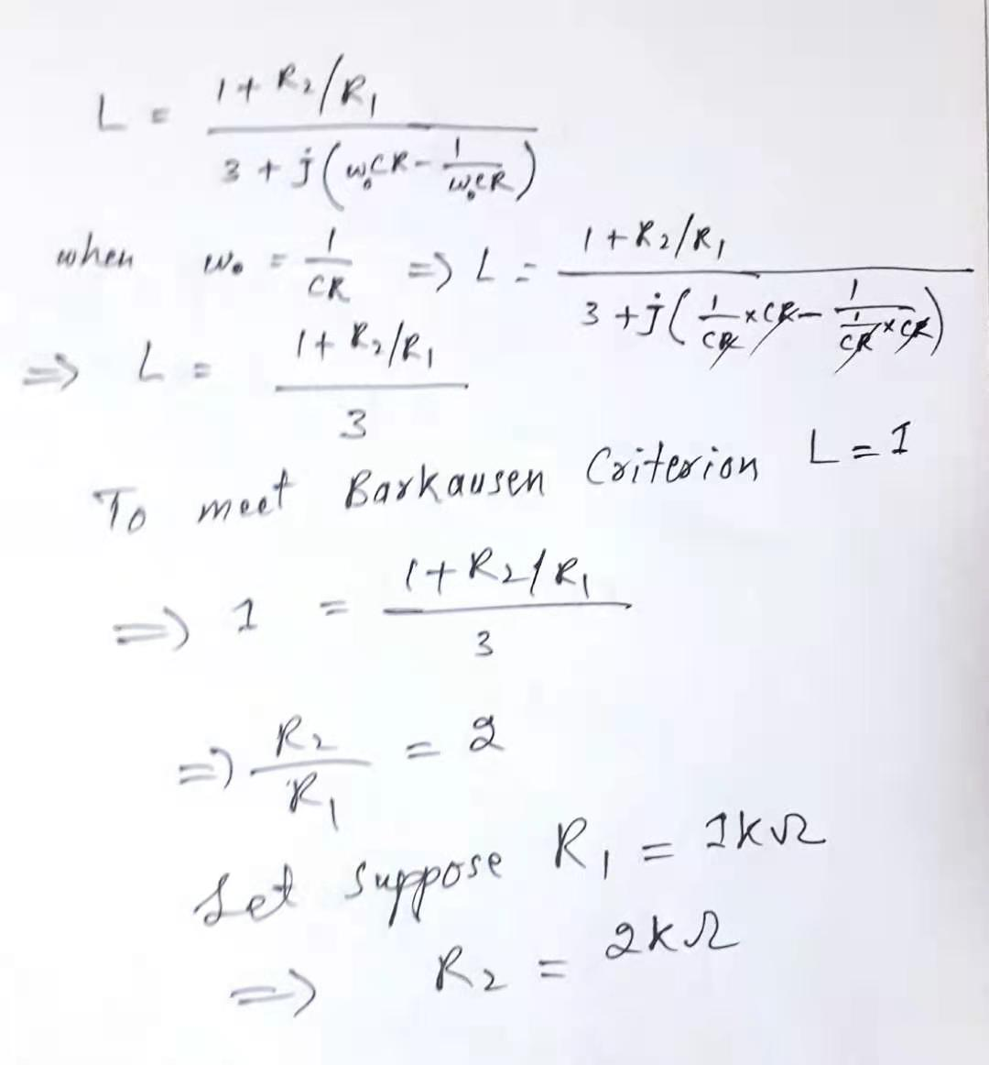
Applying Barkausen Criterion

Slide 15
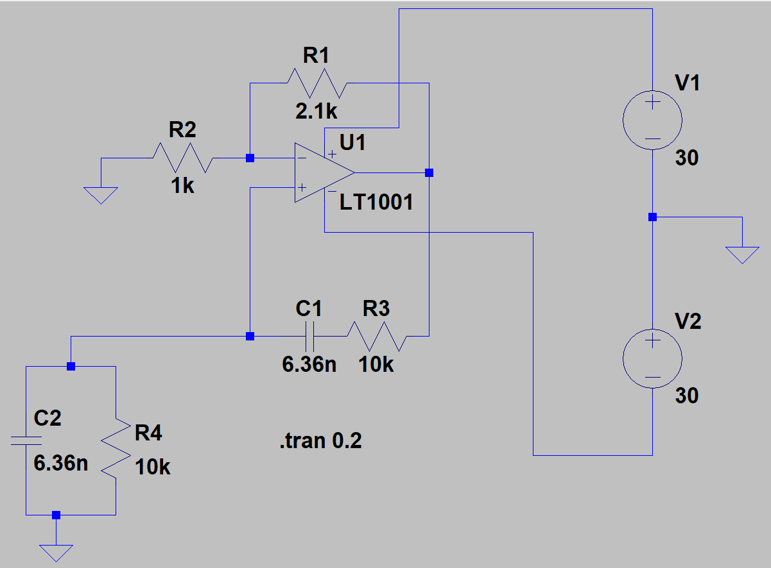
LTSpice Simulations

Slide 16
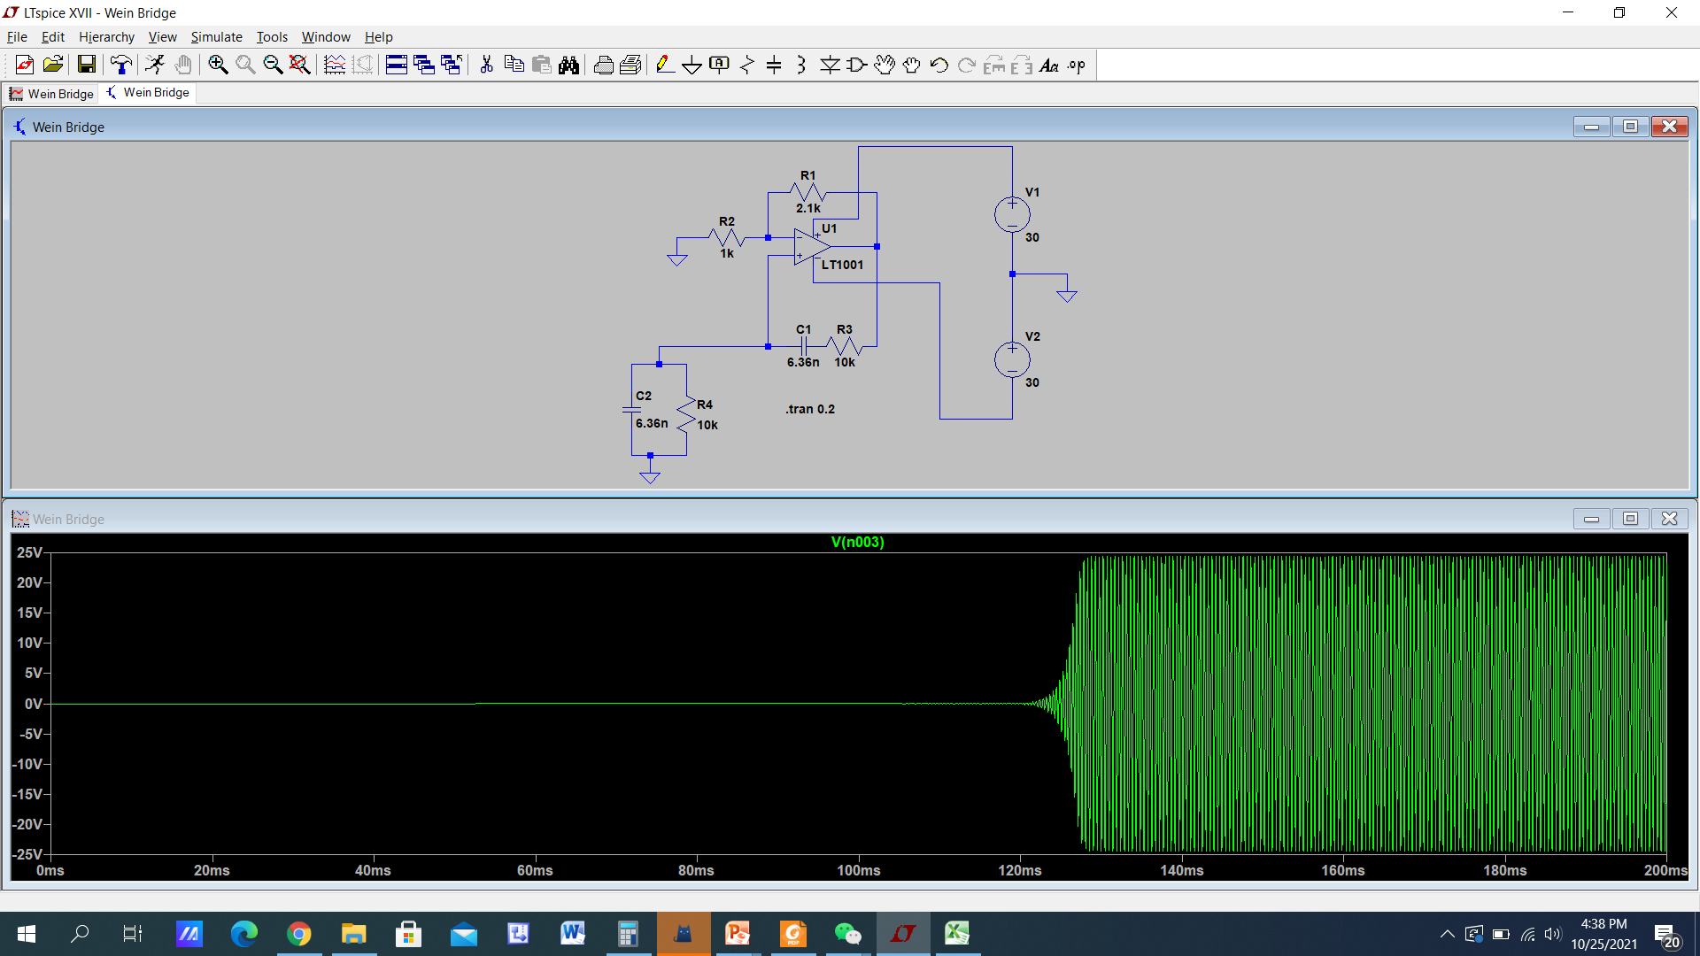

Slide 17
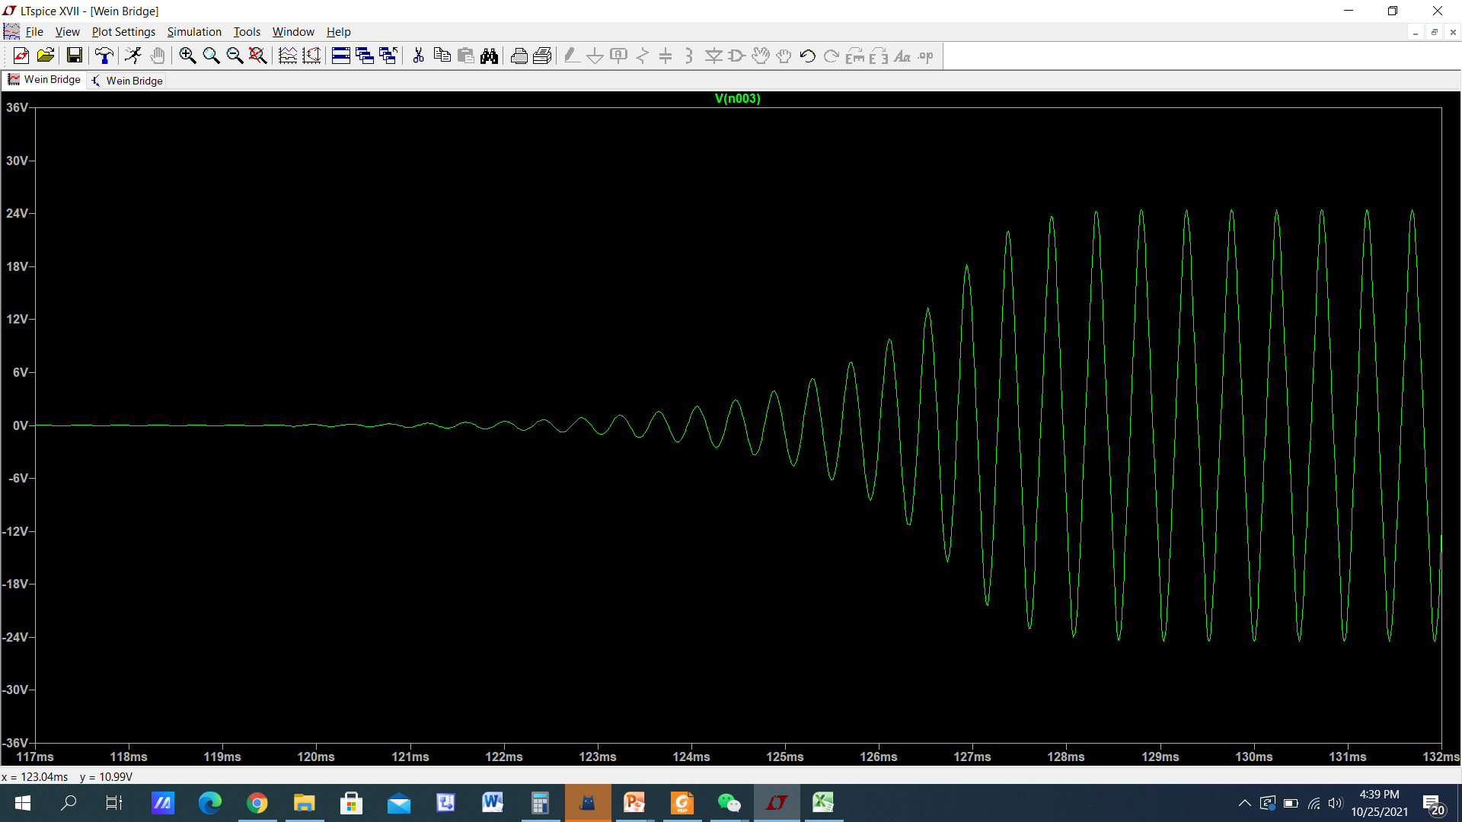
Zoom the generated waveform We got sine wave

Slide 18
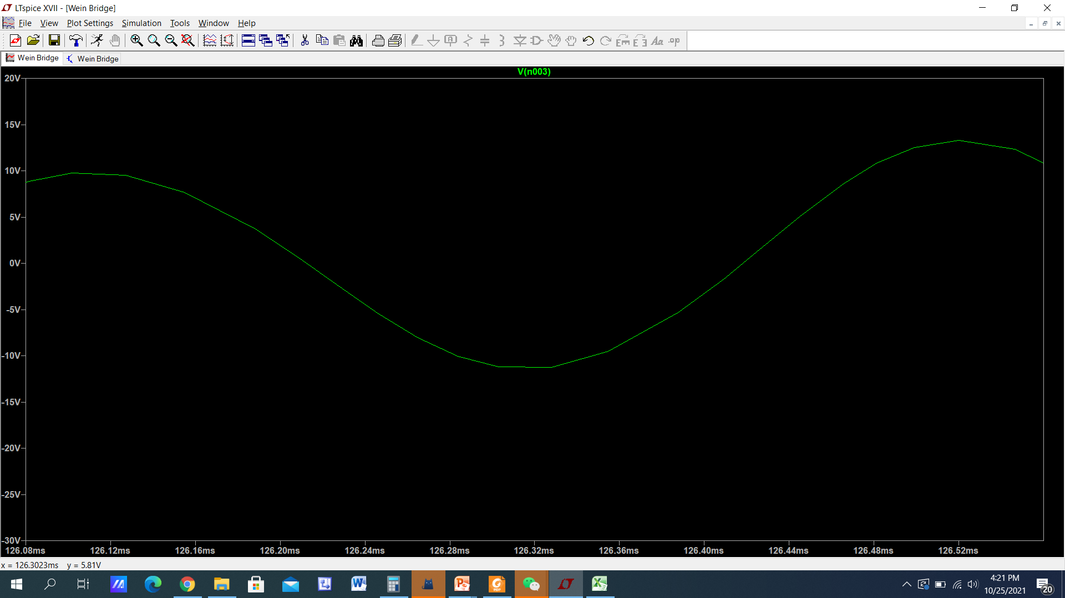
The frequency is 25kHz Time period is 400uS (126.52ms-126.12ms

Slide 19
Phase Shift Oscillator
Consists of –Ve feedback and capacitor and resistor in ladder network.
The 180° phase shift in the equation Aβ= 1∠–180° is introduced by active and passive components.
A single pole RL or RC circuit contributes up to 90° phase shift per pole, and because 180° is required for oscillation, at least two poles must be used in oscillator design.
Multiple RC sections are used in low-frequency oscillator design

Slide 20
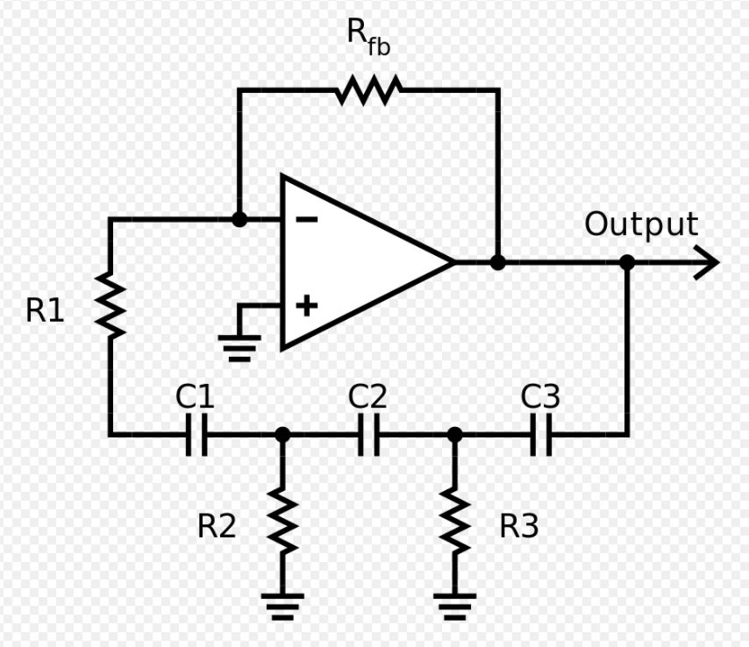
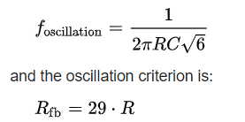

Criteria for Oscillation
R₁=R₂=R₃=R and
C₁=C₂=C₃=C

Slide 21
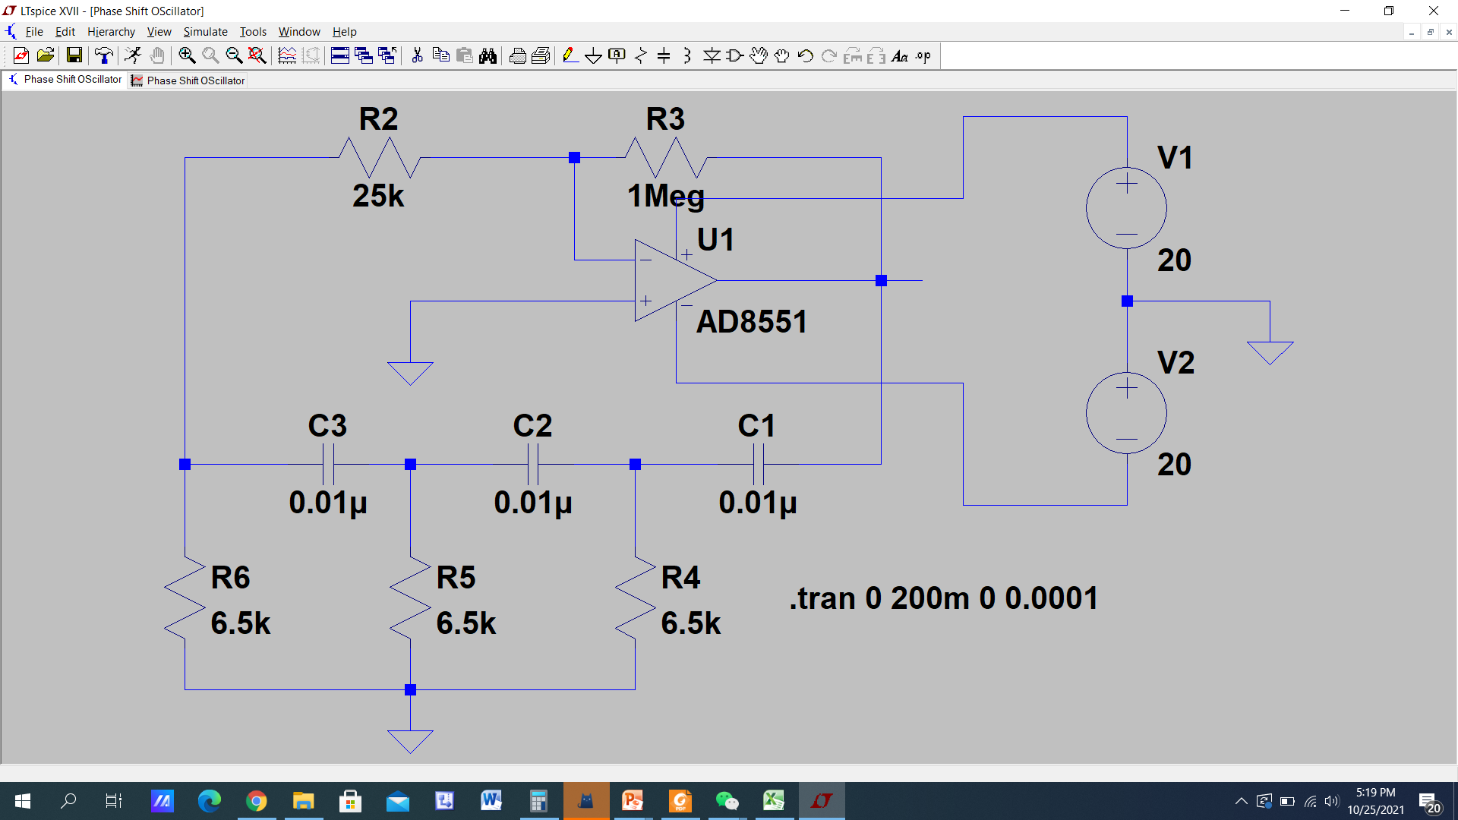

Slide 22
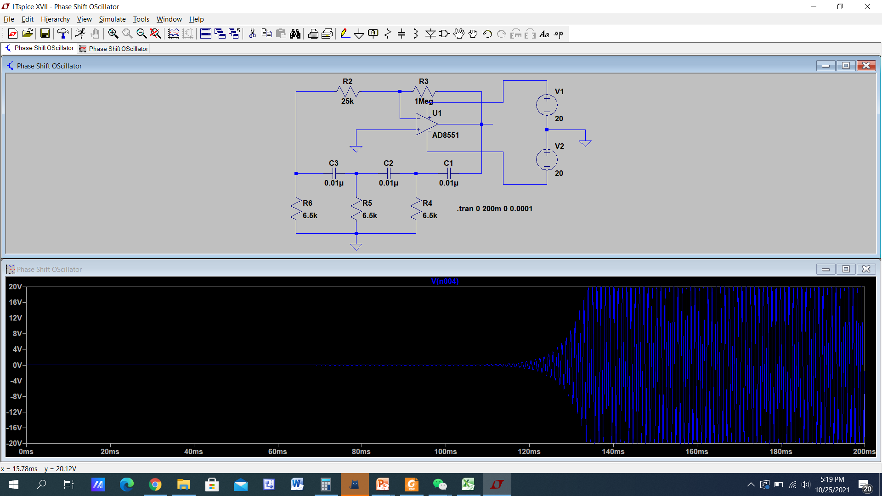

Slide 23
